Slide 1
Battle of Neighbourhoods Finding the best Neighbourhood!
By Anyway Chare

Slide 2
Introduction
This Project aims to assist people in exploring facilities in and around their neighbourhood. It seeks to help people make informed and effective decisions on selecting a neighbourhood that is right for them out of a number of neighbourhoods in Scarborough, Toronto. Many people are migrating to various states of Canada and need a lot of information on housing prices and good schools for their children. This project will therefore help those people who are looking for a good neighbourhood to stay in to make the best decision about their move. Besides housing and good schools, other factors that are important to consider for the people include access to Cafes', Supermarkets, medical centres, shopping malls, theatre, and also people of common interests among other factors. The project will analyse factors for people migrating to Scarborough and help them search for the best neighbourhoods and make comparisons between neighbourhoods. The factors that will be analysed in the project include housing price and school ratings, crime rates of particular areas, road network, weather conditions, good emergency facilities, water reticulation systems, sewerage management, and recreational facilities.

Slide 3
Problem Statement
People are migrating and they need to make informed decisions about where to settle. They are faced with the problem of choosing good neighbourhoods to settle in where crime is at a minimum and where there are important conveniences like road network, good schools, airport access, transport system, shopping centres, and others.

Slide 4
Data Description
For this project, we will use Scarborough dataset which we scrapped from Wikipedia in earlier exercises.
Dataset consisting of latitude and longitude, zip codes.
Link to the Data Set Used:
https://en.wikipedia.org/wiki/List_of_postal_codes_of_Canada:_M

Slide 5
Foursquare API Data
We will need data about different venues in different neighborhoods of that specific borough. In order to gain that information we will use "Foursquare" locational information. Foursquare is a location data provider with information about all manner of venues and events within an area of interest. Such information includes venue names, locations, menus and even photos. As such, the foursquare location platform will be used as the sole data source since all the stated required information can be obtained through the API.
After finding the list of neighborhoods, we then connect to the Foursquare API to gather information about venues inside each and every neighborhood. For each neighborhood, we have chosen the radius to be 100 meter.
The data retrieved from Foursquare contained information of venues within a specified distance of the longitude and latitude of the postcodes. This data will be used in analysing each neighbourhood in relation to amenities and other factors important to the potential resident.

Slide 6
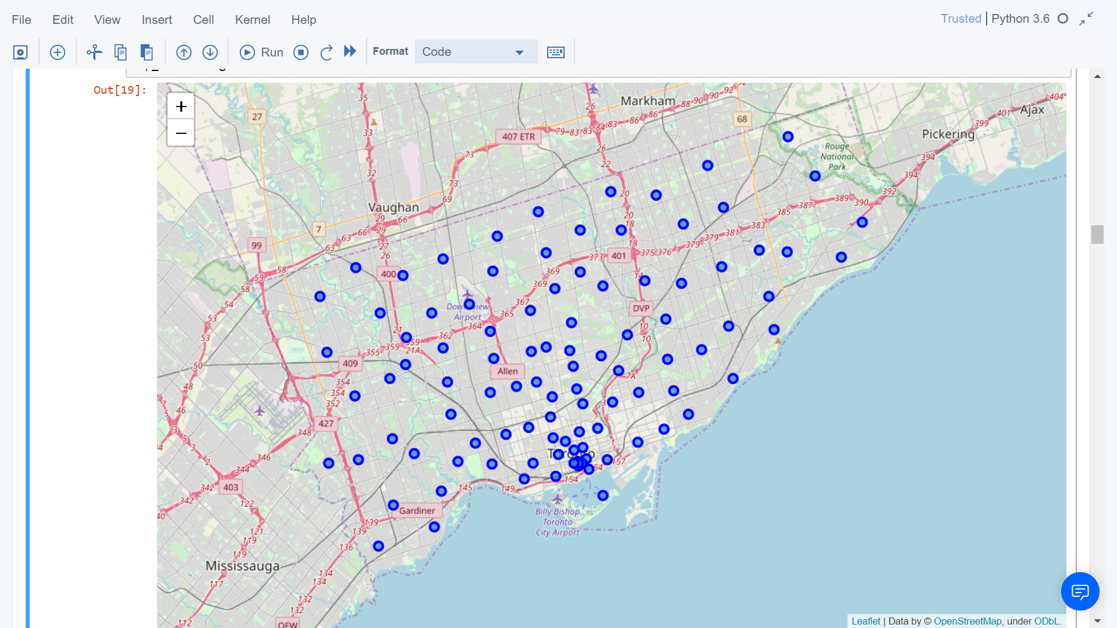
Map of Scarborough

Slide 7
Methodology
To compare the similarities of two cities, we decided to explore neighbourhoods, segment them, and group them into clusters to find similar neighbourhoods in a big city like New York and Toronto.
To be able to do that, we need to cluster data which is a form of unsupervised machine learning: k-means clustering algorithm.

Slide 8
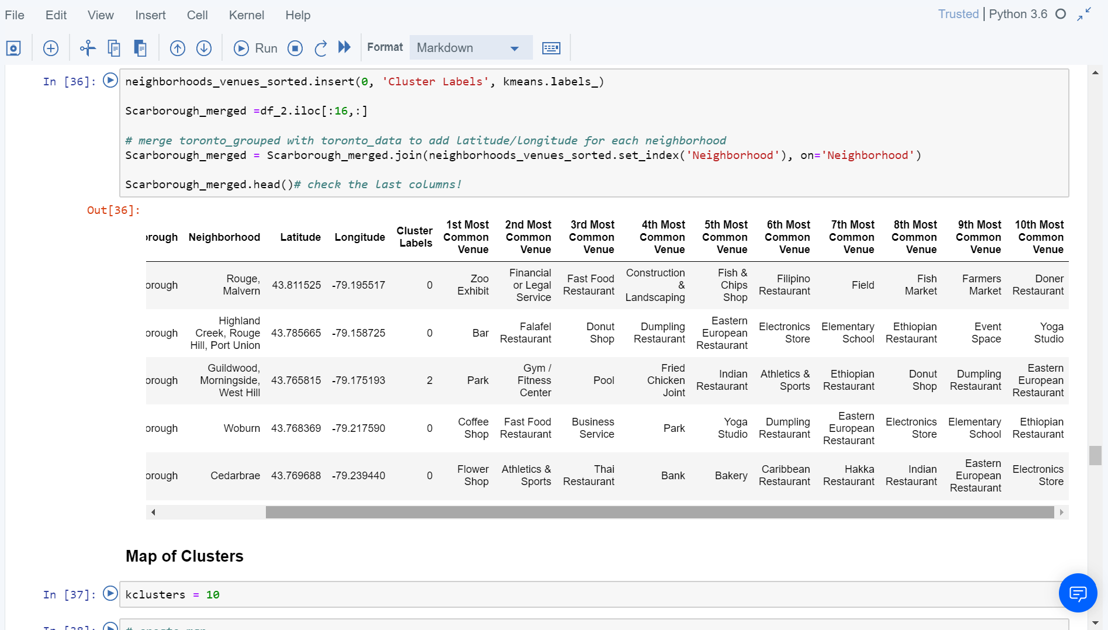
Using K-Means Clustering Approach

Slide 9
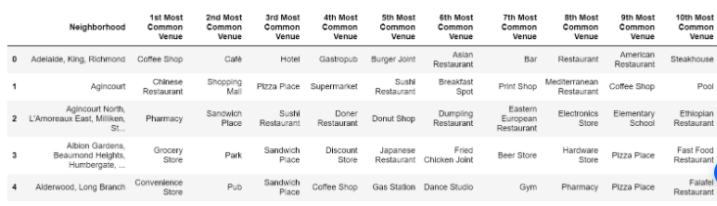
Popular Venues Near Neighbourhoods

Slide 10
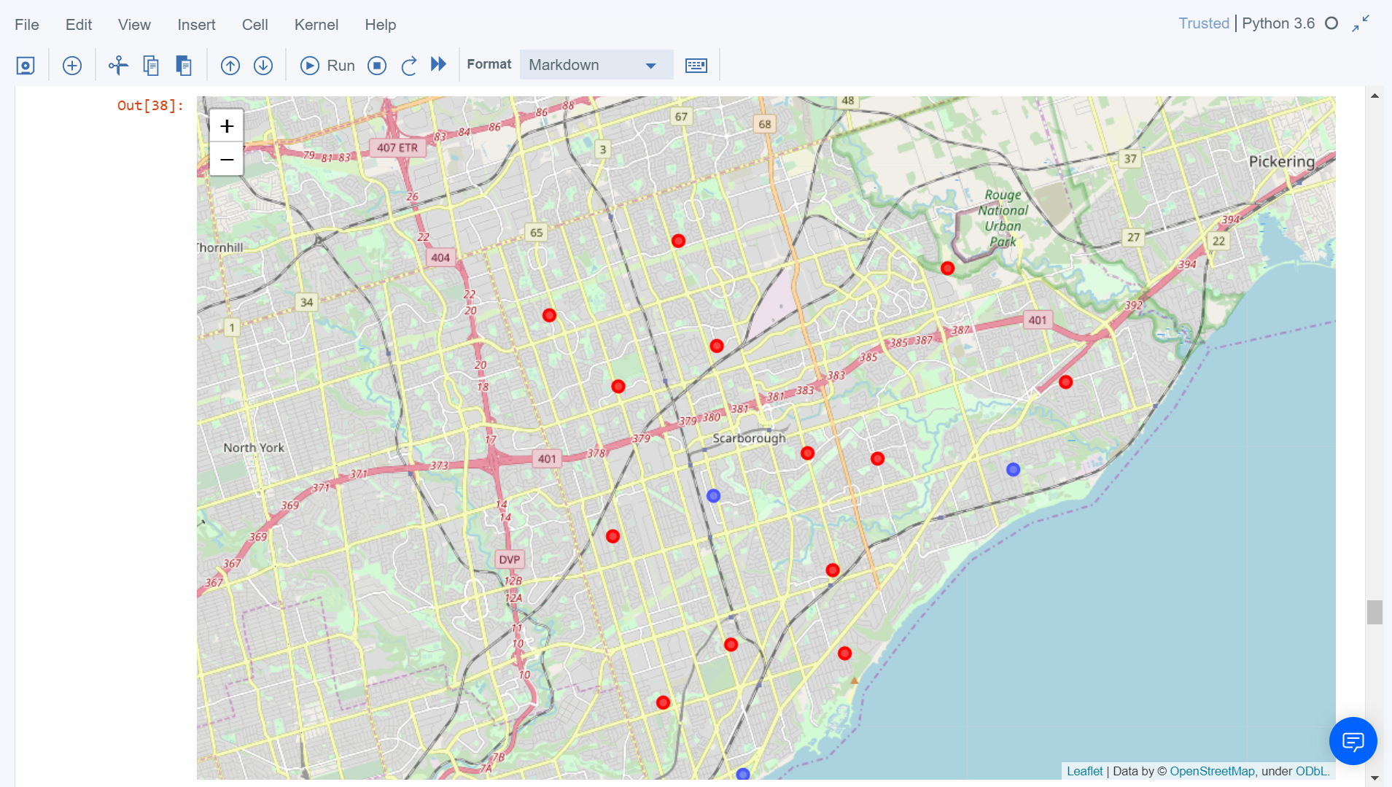
Results Clusters in Scarborough

Slide 11
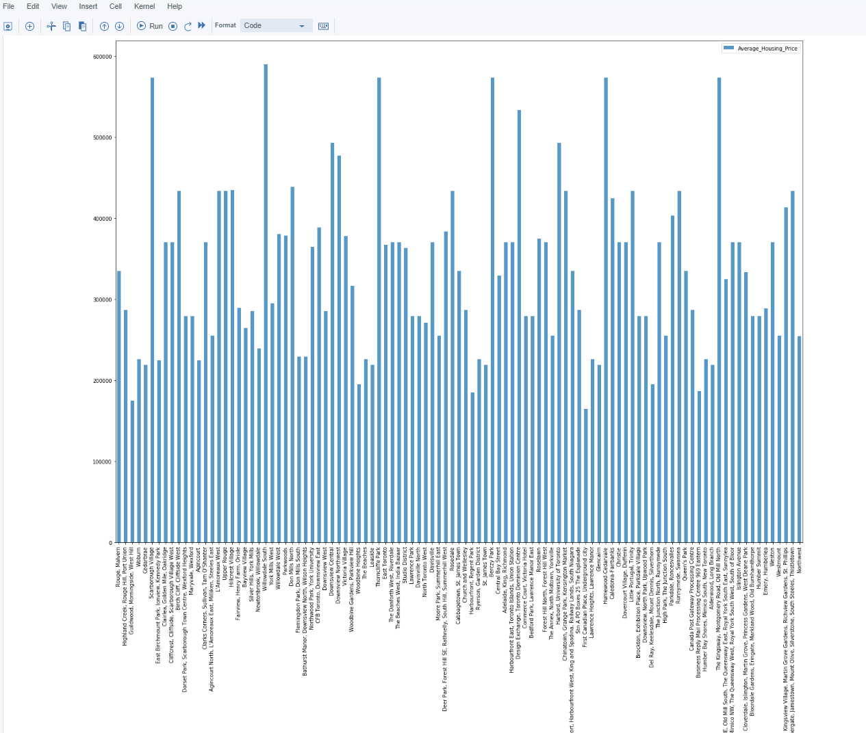
Average Housing Price by Cluster

Slide 12
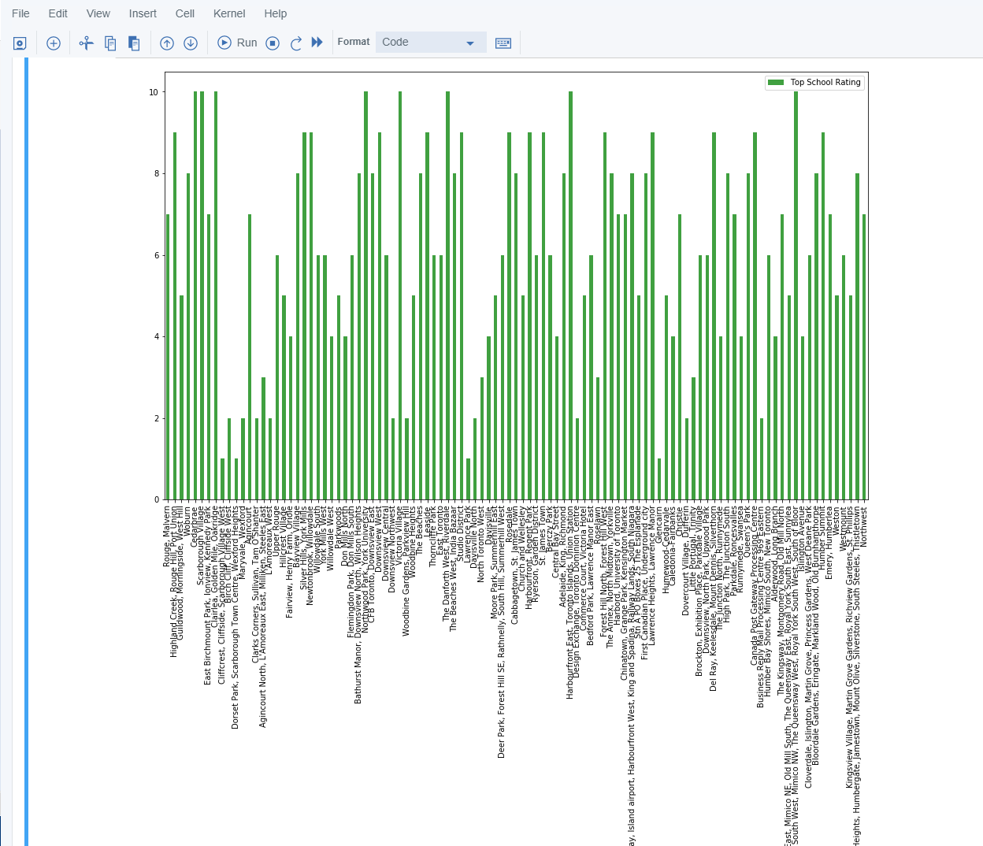
School Ratings by Cluster

Slide 13
The Best Location
Scarborough is a popular destination for new immigrants into Canada to reside in. As a result, it is one of the most diverse and multicultural areas in the Greater Toronto Area, being home to various religious groups and places of worship.
Although immigration has become a hot topic over the past few years with more governments seeking more restrictions on immigrants and refugees, the general trend of immigration into Canada has been one of on the rise.

Slide 14
Discussion
The major purpose of this project has been to analyse neighbourhoods data and suggest a good neighbourhood in a new city for people migrating to Toronto.
Social factors like minded people, access to the airport, bus transport, shopping centre, markets and other daily amenities are important to a new resident.
Sorting of data about houses according to price was important.
Also, sorting schools according to their ratings was important in the analysis, the factors here being location, fees, rating and reviews.

Slide 15
Conclusion
In the project, using k-means cluster algorithm helped the analyst separate the neighbourhoods into ten different clusters and for 103 different latitude and longitude from dataset, which have very-similar neighbourhoods around them.
Using the charts above results presented to a particular neighbourhood based on average house prices and school rating have been made.
This project has shown the possibility of a practical solution to resolve a real life situation that has personal and financial impact on people, that being possible with the use of data analysis tools.
The mapping with Folium is a very powerful technique to consolidate information and make the analysis and decision better and with confidence.

